Slide 1
Valuing Defensive Line Positions: An In-Depth Analysis
By Zach Anhalt

Slide 2
Defensive Line Positions
Utilizing classical definitions – defensive tackles (DT), defensive ends (DE), and linebackers (LB) – of defensive line positions for this analysis
Aligns with NFL’s franchise tag positions, which provides an assessment of value as defined by average salary
Evaluated linebacker contributions both when lined up on and off the defensive line
Considered using a line technique approach to labeling positions; may be worth further pursuit

Slide 3
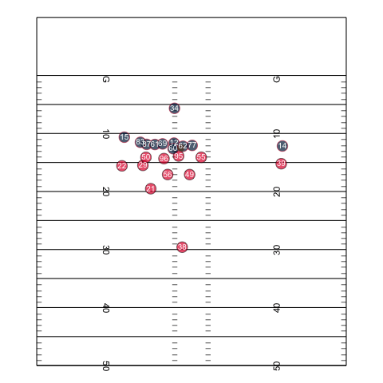
Defensive Tackles
Defensive Tackles typically line up in the center of the defensive line, across from the interior offensive linemen (techniques 0-3)
Defensive Tackles need to be strong enough to hold the point of attack on rushing plays and push the pocket on passing plays
The animation (run as a slideshow) on the right shows Bennie Logan (#96) stopping Rex Burkhead (#34) for a short gain on a run up the middle

Slide 4
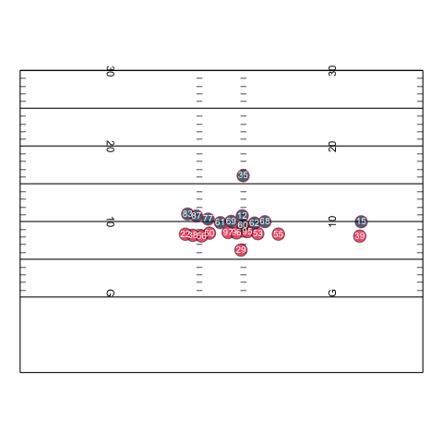
Defensive Ends
Defensive Ends typically line up at each end of the defensive line (techniques 3-9)
Defensive Ends must be able to hold their position on rushing plays and have the speed to get outside their blocker on both passing and rushing plays
The animation on the right shows Allen Bailey (#97) stopping Mike Gillislee (#35) short of a first down on a crucial 4th down run

Slide 5
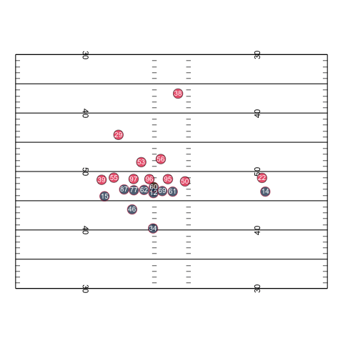
Linebackers
Linebackers typically line up behind the defensive line, but are also deployed on the defensive line, often as “edge rushers” (9 technique)
Edge rushers, like Khalil Mack and Von Miller, operate almost exclusively as defensive linemen with the primary mission of getting into the opponent’s backfield
The animation on the right shows Justin Houston (#50) lining up on the outside of the defensive end and stopping the misdirection run

Slide 6
The Most Valuable Defensive Lineman
Pressures/sacks the quarterback on passing plays
Approximately 59% of the total plays in the competition data were pass plays
A sack increases the probability of a drive ending with a punt by 18%
Stops the run
Depending on the scheme, they may focus more on occupying blockers than tackling the ball carrier
The five (5) worst teams in opponent yards/carry from the competition data struggled to win in the latter half of 2019
Texans (5-3 record)
Jaguars (2-6 record)
Panthers (1-8 record)
Redskins (2-6 record)
Browns (4-5 record)

Slide 7
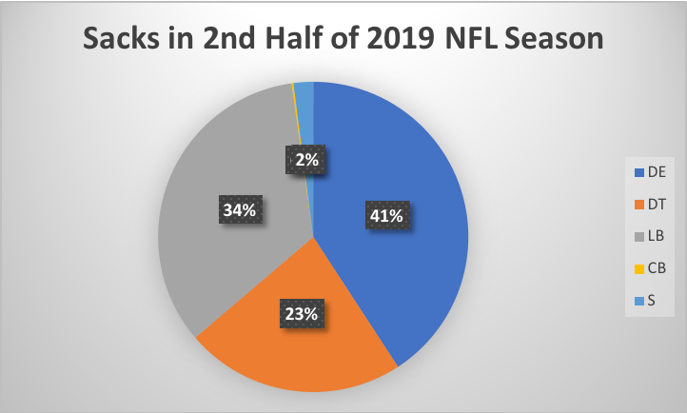
Pressuring / Sacking the Quarterback
Defensive Ends register the most pressures and sacks among defensive linemen
DE’s register 7% more sacks than the next defensive line position
They also register 11% more pressures than the next position group

Slide 8
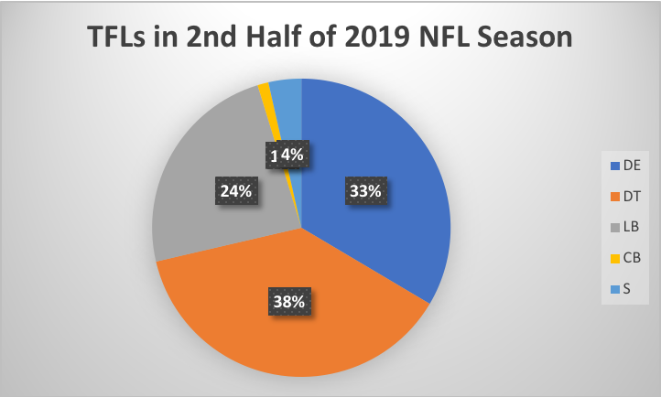
Stopping the Run
Defensive Tackles registered the most tackles for loss (TFL’s) on running plays
About 5% more than the next position group
DTs register the most tackles out of all defensive positions
About 100 more Tackles than the next position group (Defensive Ends)

Slide 9
Conclusion
Defensive End is the most valuable position on the defensive line
Defensive Ends do the best job of applying pressure on the QB
There were 94 DE’s who registered four (4) or more pressures in the competition data; 15 more than the next defensive line position
DE’s registered the second most tackles and TFL’s on rushing plays

Slide 10
Why Not Linebackers?
There is an argument that LBs do the best job of getting to the QB
Not all LBs rush the QB, many drop back in coverage
Filtered the competition data to get only players who have registered four pressures or more
This effectively eliminated linebackers who are not frequent pass rushers
In the filtered dataset, Linebackers had an average of 2.79 Sacks and 15.90 Pressures per player, which exceeded Defensive End respective averages of 2.28 and 14.84
Defensive Ends are still more valuable
The separating factor is the performance against the run game
While both get to the QB at similar rates, DEs registered 9% more TFL’s and around 250 more tackles as a group

Slide 11
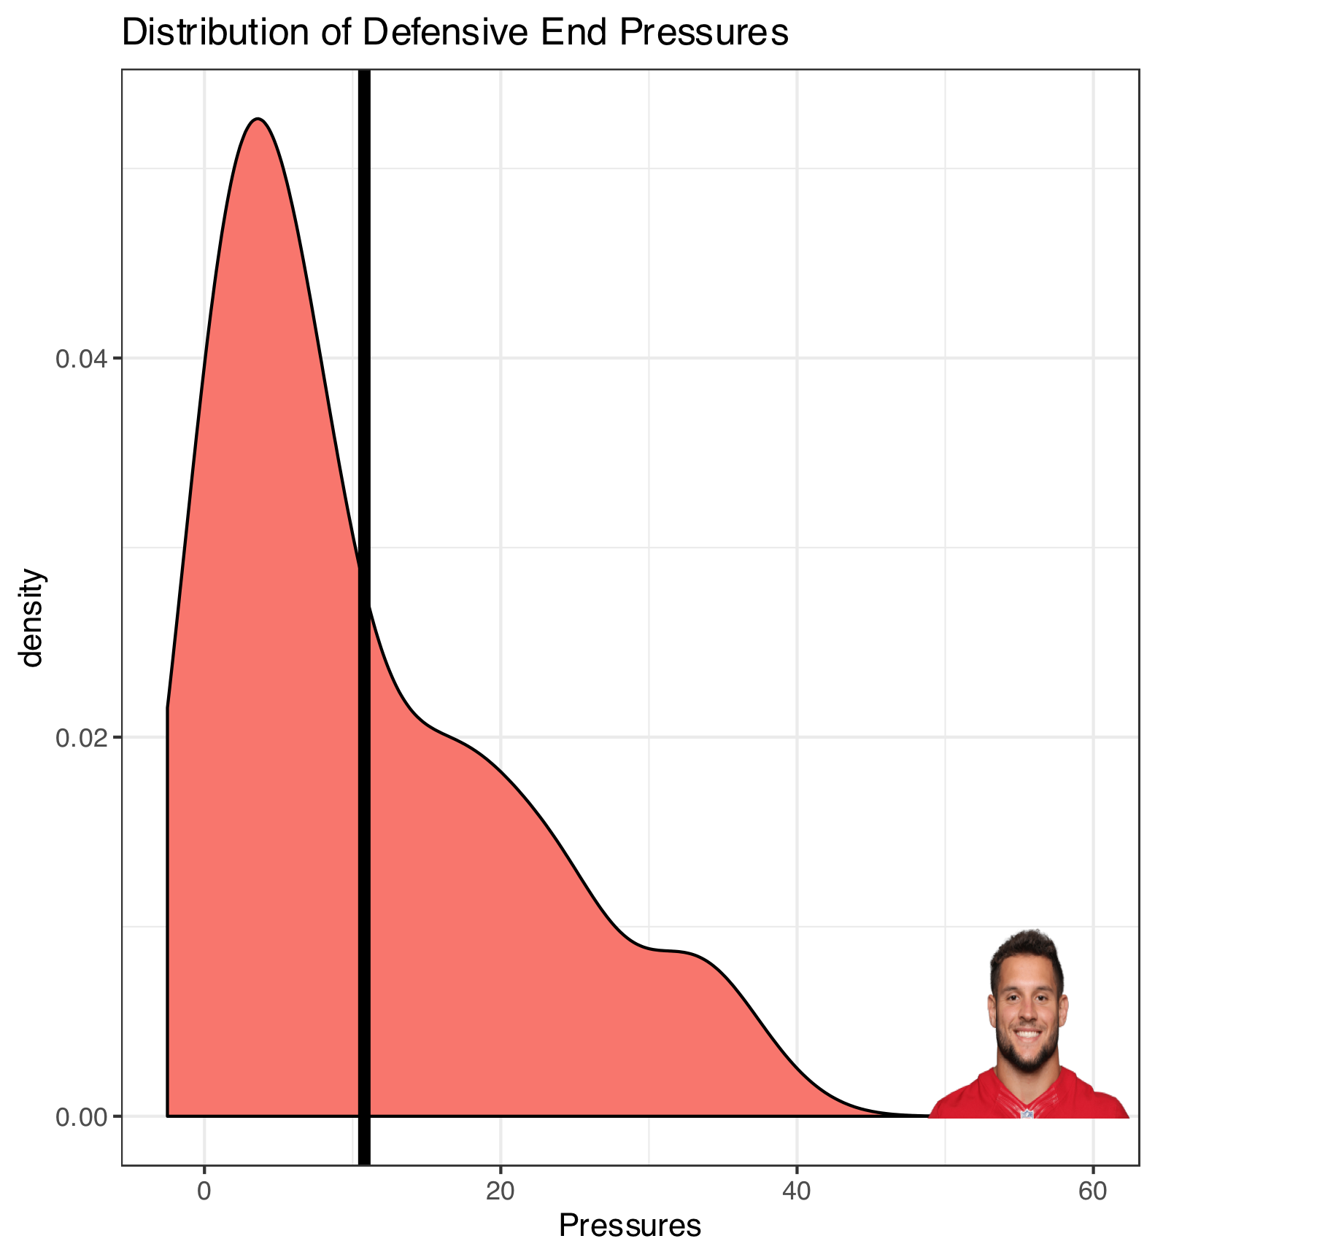
Distribution of Talent: Defensive Ends
Defensive Ends registered the most pressures out of all position groups on the defensive line
The average DE registered 10.8 pressures in the back half of 2019
The average Pro Bowl DE registered 30.4 Pressures in the same time period

Slide 12
Distribution of Talent: Defensive Tackles
Defensive Tackles seemed to have the smallest distribution in talent on the defensive line
Defensive Tackles led the way for most tackles in the second half of the 2019 regular season
The average DT registered 9.7 Tackles in the competition data
The average Pro Bowl DE registered 19.5 tackles in the same time period

Slide 13
Distribution of Talent: Linebackers
Linebackers have the largest distribution in talent
Filtered data to get only LBs registering four (4) or more pressures in the latter half of the season
The average LB recorded 15.9 Pressures in the competition data
The average Pro Bowl LB recorded 37.7 Pressures in the data
Analyzed performance considering where Linebackers lined up
Some LBs benefit from lining up behind the defensive line, e.g., Chandler Jones recorded 10.5 Sacks in the second half of the season, but lined up on the defensive line for just two of them
But some LBs who lined up on the ends of the Defensive Line posted great numbers, e.g., TJ Watt registered 82.4% of his sacks from the defensive line

Slide 14
Roster Construction Effect
Defensive Line positions can have differing values to teams based on how their defense is organized
Some teams like to pressure the quarterback with more heavy-set defensive linemen with LBs lined up behind them; traditional 4-3 and 3-4 formations
Other teams like to use a variety of packages to blitz different position groups
Matt Patricia, Head Coach of the Detroit Lions, was quoted as saying the traditional 4-3 and 3-4 defensive formations are obsolete in today’s age of football
Using different packages to utilize many defensive backs and versatile linebackers has been a rising trend among some NFL teams
Several team examples follow

Slide 15
New Orleans Saints
Most Valuable Defensive Line Position: Defensive End
Performed best against the pass
Recorded most of the sacks and pressures
Also performed best against the run
Recorded the most TFLs and tackles on run plays
Notable players who exceled on the defensive line:
Cameron Jordan, Demario Davis

Slide 16
Carolina Panthers
Most Valuable Defensive Line Position: Defensive Tackle
Performed best against the pass
Recorded most of the sacks and pressures
Performed best against the run
Recorded the most TFLs and tackles on run plays
Notable players who exceled on the defensive line:
Gerald McCoy, Mario Addison, Bruce Irvin

Slide 17
Pittsburgh Steelers
Most Valuable Defensive Line Position: Linebacker
Performed best against the pass
Recorded most of the sacks and pressures
Performed best against the run
Recorded the most TFLs and tackles on run plays
Notable players who exceled on the defensive line:
TJ Watt, Bud Dupree, Cameron Heyward

Slide 18
Game Situation Effect
Game situation can play a factor in the performance of different defensive line positions
Compared stats at start of first (1st) quarter and end of the fourth (4th)
In the beginning of the game, LBs had the most sacks out of defensive line positions, having 7% more sacks than the next group
In the last 7.5 minutes of the game though, DEs had most of the sacks, providing major help in crucial game moments

Slide 19
Game Situation Effect
Compared defensive line performance on running plays in different game scenarios
Filtered fourth (4th) quarter situation where the team on defense is trailing late
DTs performed well in both scenarios, consistently stopping the run during the game
The difference is that LBs performed worse against the run late in the game while DEs stepped up, showing a 12% increase in TFLs

Slide 20
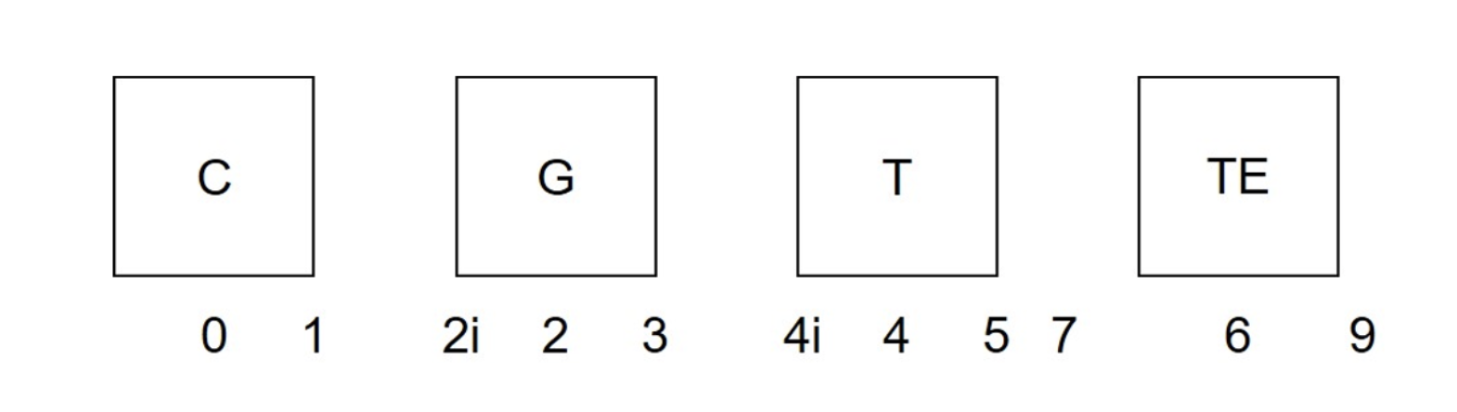
Analyzing Different Techniques
Techniques that worked the best
Those that are in between Offensive Linemen or on the outside
Technique shows that those at the ends of the defensive line typically have the most success in the NFL
Not for every team depending on defensive strategies

Slide 21
Limitations and How to Expand Project
The dataset was relatively small; credibility would have been enhanced with a more robust dataset
With more time and more data it would have been possible to develop a predictive model for defensive line statistics
Factor in opponent, defensive coordinator tendencies, performance from previous games
Could show teams what to expect when a certain defensive linemen is on the other side of the line of scrimmage

Slide 22
Conclusionary Thoughts
From a league-wide perspective, Defensive End is the most consistent, valuable position on the defensive line
Analyzing the distribution of talent of each defensive line position yielded interesting results
Defensive Tackle had the smallest distribution of talent; perhaps the most replaceable position on the defensive line
Linebacker had the largest distribution of talent
Linebackers have multiple responsibilities, so those who drop back in coverage may not put up great pass-rushing statistics
Value is subjective to each NFL team, and each team organizes their defense differently
Each defensive line position can be more valuable than the next based on the team
Most valuable defensive line position for Steelers = LB
Most valuable defensive line position for Saints = DE
Most valuable defensive line position for Panthers = DT

Slide 23
Sources
https://www.nfl.com/news/nfl-reveals-rosters-for-2020-pro-bowl-in-orlando-0ap3000001089218
https://www.foxsports.com/nfl/team-stats?season=2019&week=100&category=DEFENSE
https://www.post-gazette.com/sports/steelers/2019/04/22/steelers-NFL-draft-mike-tomlin-defensive-subpackages/stories/201904210149
https://www.pro-football-reference.com
https://www.espn.com/nfl/standings
https://fivethirtyeight.com/features/exactly-how-much-does-a-great-pass-rush-hurt-an-offense/
https://sportsinfosolutionsblog.com/2020/06/24/a-quick-introduction-to-our-analytics-challenge-data-set/
https://github.com/nfl-football-ops/Big-Data-Bowl
Used public data for gifs provided on slides 3-5

